Slide 1
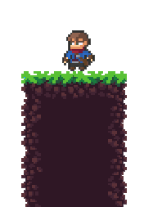

>>
Forest
Runner
NUMERICAL ALGORITHMS AND NUMERICAL SOFTWARE
^{SUBJECT PROJECT}

Slide 2
THE CONTENT



In the introductory part of the presentation, we will deal with the basic problems that should have been dealt with during the development of the project.
We will further deal with the realization of the project and the way in which we solved the mentioned problems.
At the end, we will present the project itself and solutions to the problems we came up with.

Slide 3

01.
INTRODUCTION

Slide 4
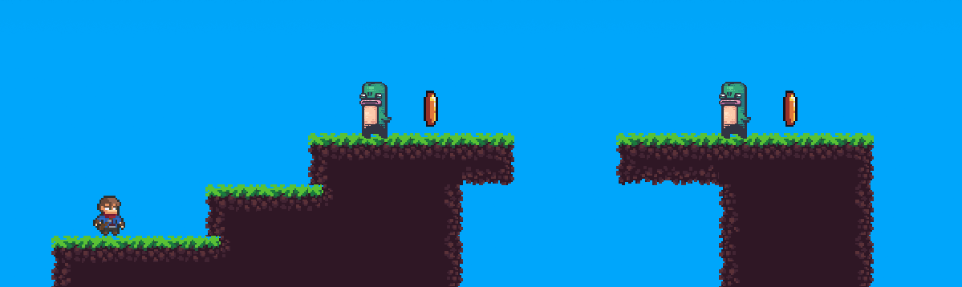
WHAT IS FOREST RUNNER
Forest Runner is a platformer game based on already existing Super Mario game.
The goal of the game is to neutralize all enemies, collect as many gold coins as possible and collect the key that takes you to the next map.

SADIPISCING ELITESI PRAESENT ETES QUAM DIAMES MORBIS MALESUDA NISL EPSUM, EGET DIGNISSIM ESTUS MORONO PORTOS CORDO

Slide 5
PROBLEMS FOR PROCESSING
PLAYER – ENEMY COLLISION
When detecting a collision between the player and the enemy, it is necessary to return the player to starting position and remove 1 life from him
PLAYER MOVEMENT
Allow the player to move around the map and stop their movement when they hit a block.
BALL MOVEMENT
The ball should have an ascending – descending trajectory and its movement should be regulated when it comes into contact with the surface.
KILLING THE ENEMY
When detecting a collision between the ball and the enemy, it is necessary to delete that enemy from the map.
BALL ROTATION
When the ball moves, it has its own rotation based on which it bounces off the surface.
COLLECTING OBJECTS
When the player comes into contact with one of the objects that he can pick up, a certain benefit that object carries is added to him.

Slide 6

02.
PROJECT DEVELOPMENT

Slide 7
IMPLEMENTED METHODS
^{RK4 METHOD}
Movement of player and ball across the map.
^{SQUARE-on-SQUARE}
Collision detection between player and surface, enemy and surface and objects and surface.

Numerical methods were used to create the project which enabled the movement of elements on the map as well as collision detection.
^{SQUARE-on-CIRCLE}
Collision detection between player and ball, enemy and ball and player and objects.
THE LAW OF CONSERVATION OF IMPULSE
^{Ball rotational movement.}

Slide 8
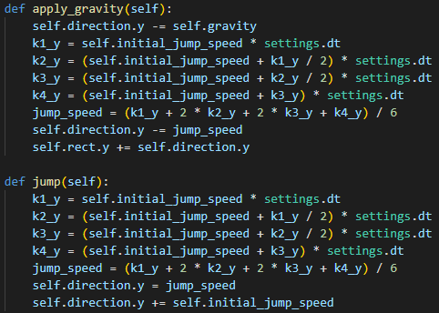
PLAYER MOVEMENT
To simulate the player’s movement, we used the RK4 method, which we combined with collision detection to limit the movement.
The horizontal movement of the player is done independently of the vertical movement.
Vertical movement differs from horizontal movement only in that gravity is additionally introduced.

Slide 9
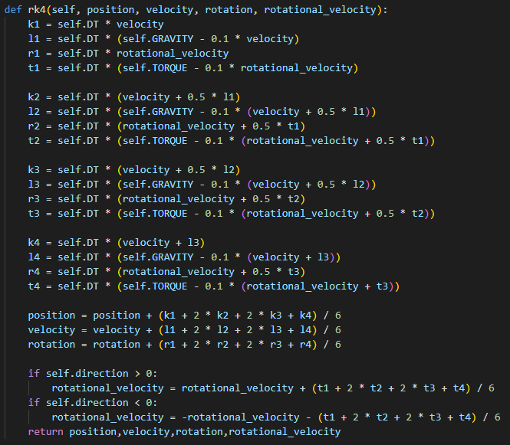
BALL MOVEMENT
To simulate the movement of the ball, we user RK4 method, which we combined, both with collision detection to limit the movement, and with elements of rotational movement.
The ball has an ascending-descending path, after which it continues to move depending on the rotation.
After falling, the ball retains a certain momentum that gives it the ability to bounce several times before stopping.

Slide 10
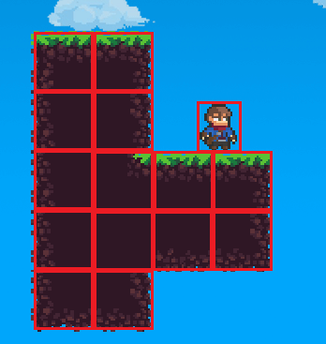
COLLISION DETECTION
Collision detection was performed using the SAT method in two forms:
Square-on-square
Circle-on-square
PLAYER – SURFACE COLLISION
In order to limit the player’s movement on the map, we used square-by-square collision detection.
PLAYER – BALL COLLISION
If the player fired the ball and it did not fall out of the map, the player is able to pick it up. For each collected ball, the player gets a free throw. Here we used circle-on-square collision.

Slide 11
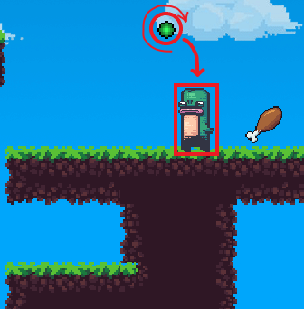
BALL – SURFACE COLLISION
If the player misses the enemy, the ball comes into contact with the surface which should limit its further movement. We used circle-on-square collision.
BALL – ENEMY COLLISION
If the player did not miss, there is a collision between the enemy and the ball and this also represents a circle-on-square collision.
PLAYER – ENEMY COLLISION
If the player and the enemy come into contact, it is necessary to detect it and remove one life from the player. Collision detection used for this case is square-on-square.

Slide 12
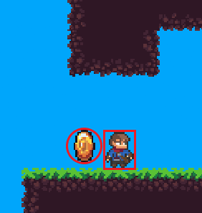
COLLISION DETECTION
(COLLECTING OBJECTS)
PLAYER – OBJECT COLLISION
By starting a level, the objects that are intended for the given level are loaded on the map.
During the game, the player is able to collect objects around the map such as coins, extra life and key that leads him to the next map.
The player collects objects by coming into contact with each one of them and then one of two forms of collision is detected depending on the object.

Slide 13
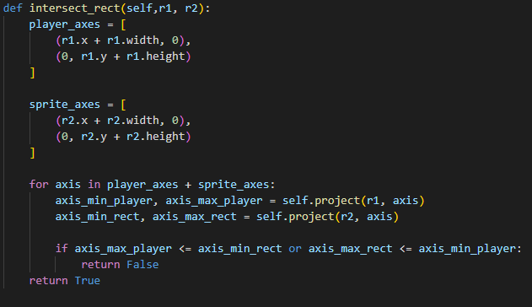
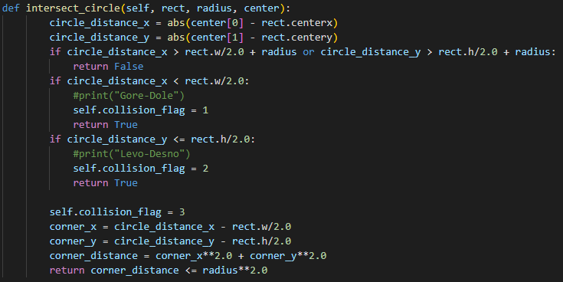
SAT METHODS
SQUARE-on-SQUARE
Classic SAT method to which we pass the rect’s of the objects to be collided.
CIRCLE-on-SQUARE
SAT method to which, unlike the previous one, we pass the rect of the square object along with the center and radius of the ball.

Slide 14

03.
FINAL
SOLUTION

Slide 15
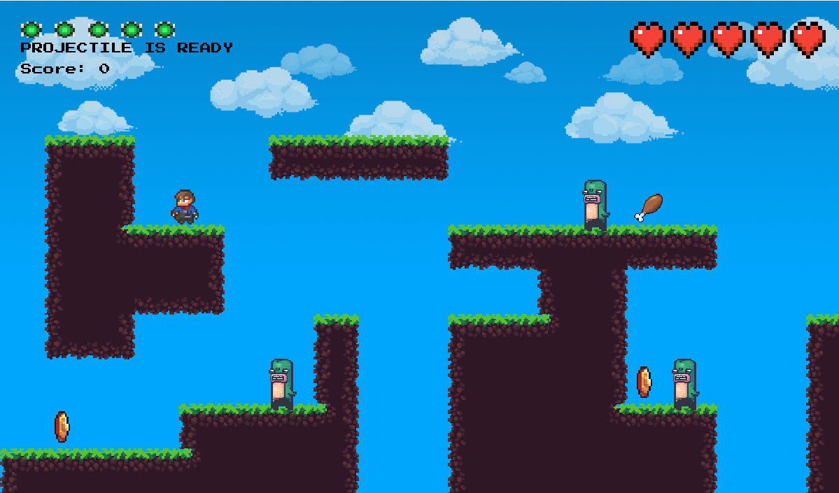
GRAPHICS PROCESSING
Since it has already been said that the game is based on the popular platformer Super Mario, the graphics have been done accordingly.
ANIMATIONS
For a better experience, the player and most part of the game environment is animated.
MAP
Each level has its own map and every other map is bigger then the previous one.
END OF THE GAME
After the player has passed all of the offered levels he is considered to have passed the game and is free to choose the map he wants to play.

Slide 16
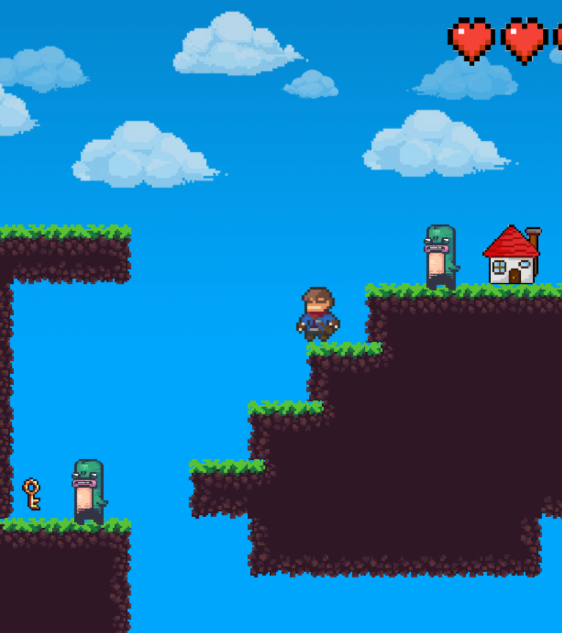
REFERENCES
https://silo.tips/download/projectile-motion-using-runge-kutta-methods
01.
02.
https://stackoverflow.com/questions/75347257/sat-algorithm-for-collision-detection-problem
03.
https://www.youtube.com/watch?v=uJXs4ICg95g&ab_channel=ShamsElFouly
04.
https://www.youtube.com/watch?v=YWN8GcmJ-jA&t=5608s&ab_channel=ClearCode

Slide 17
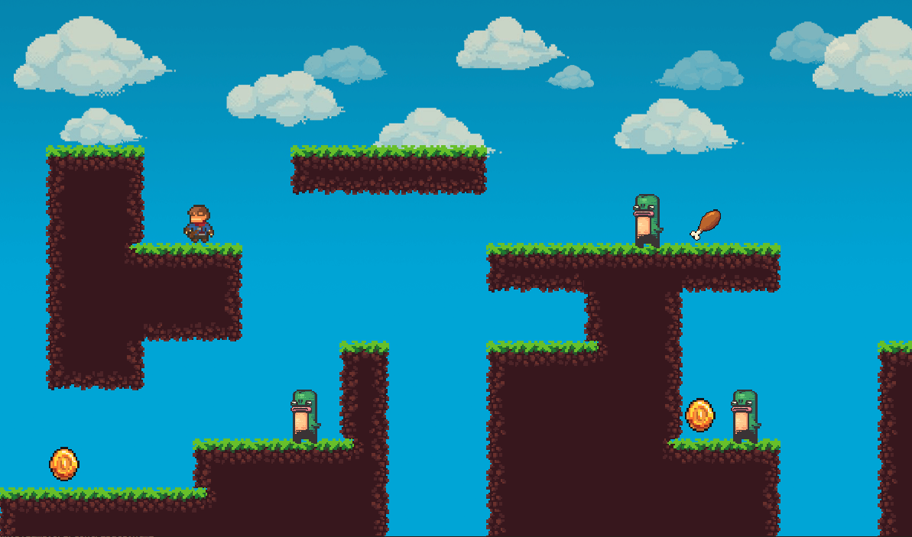
THANK YOU FOR YOUR ATTENTION

